Slide 1

Walmart Sales Forecasting
Shubhangi Ranjan

Slide 2





Agenda
PROJECT BACKGROUND
RESEARCH FOCUS
DATASET
DATA PREPARATION
EXPLORATORY DATA ANALYSIS
FEATURE
SELECTION
MACHINE LEARNINGMODELS
PERFORMANCE METRICS
CONCLUSION
RECOMMENDATIONS
FUTURE WORK

Slide 3
Project Background
Application domain: retail/e-commerce for Walmart
Main research focus: How to forecast sales accurately?
To improve business strategies and increase revenue for retailers by:
Understanding of customer trends/behavior
Understanding impact of marketing events
Understanding how holiday markdown events like Labor Day, Thanksgiving, Christmas affect sales
Understanding seasonality of sales
Main beneficiaries: Walmart stakeholders
Notes:
Walmart: American multinational retail corporation which operates a chain of hypermarkets, discount department stores, & grocery stores.
Walmart would benefit from this analysis

Slide 4
Research Questions
What factors affect weekly sales for Walmart stores?
How can we accurately forecast sales of Walmart stores?
Which machine learning model is the best at forecasting sales?
To answers these questions, we have attempted to:
Clean data
Analyze trends, patterns, and correlations of data
Identify important factors
Process data for modelling
Tune models through CV
Compare models based on RMSE, MSE & WMSE metrics
Select the best model

Slide 5
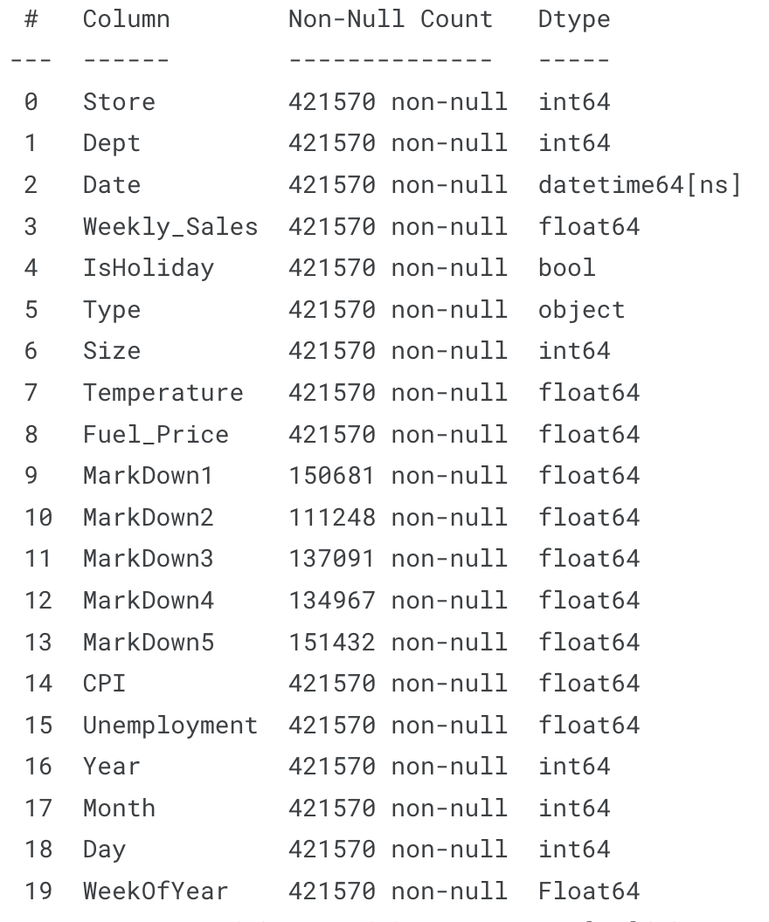
Walmart Dataset
Data Source: Kaggle (containing train, test, features, and test files)
Historical sales data of 45 Walmart stores from 2/5/2010 to 11/1/2012
Target variable: "Weekly_Sales"
Markdown columns represent marketing events
Variety of socio-economic factors such as CPI, Fuel Price, Unemployment are present.
Notes:
81 Departments.
Some NA values are present.

Slide 6
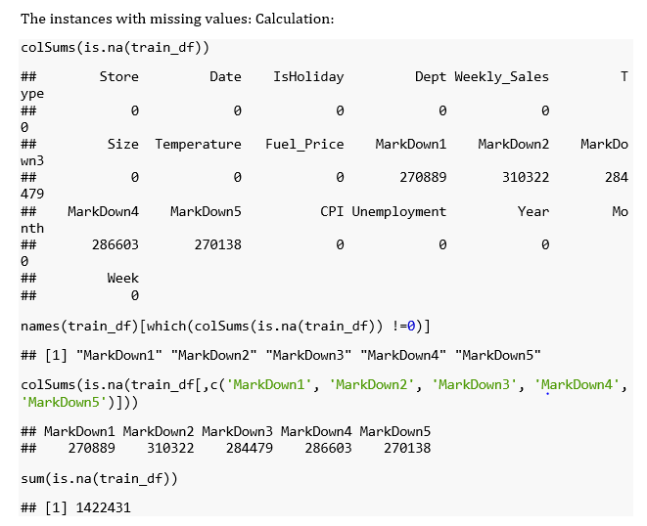
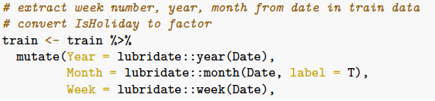
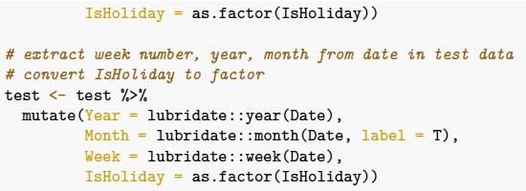
Data Preparation: Missing values, IsHoliday Weight (convert into factor datatype), Extracting Date
Holidays have 5times impact on sales.
Notes:
Large number of missing values

Slide 7

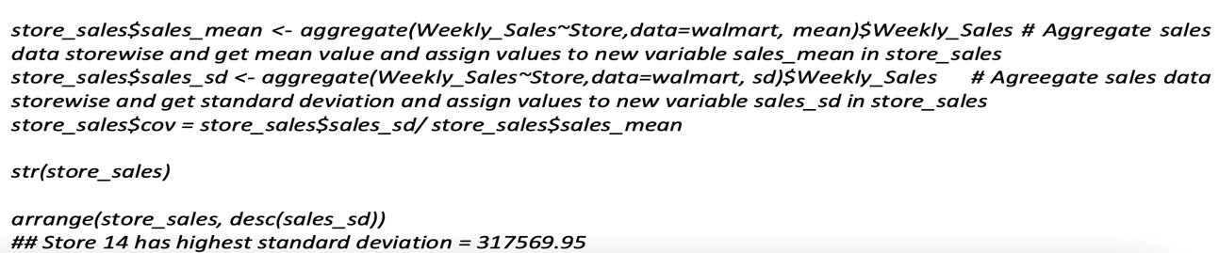
Exploratory Data Analysis
Store 20 has the highest sales
Store 14 has the most varying sales
Store 7 had highest growth rate of 13.33%
Notes:
A) analyze trends, patterns, and correlations of data

Slide 8
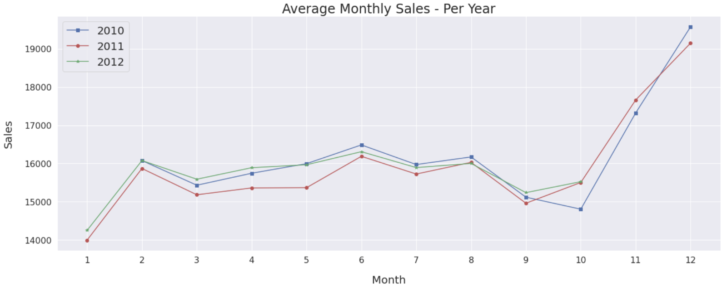
Exploratory Data Analysis
Walmart booked highest sales in Dec 2010 and Dec 2011 and lowest sales in Jan 2011 and Jan 2012
December is month of highest sale and is followed by lowest sale in month of January.

Slide 9
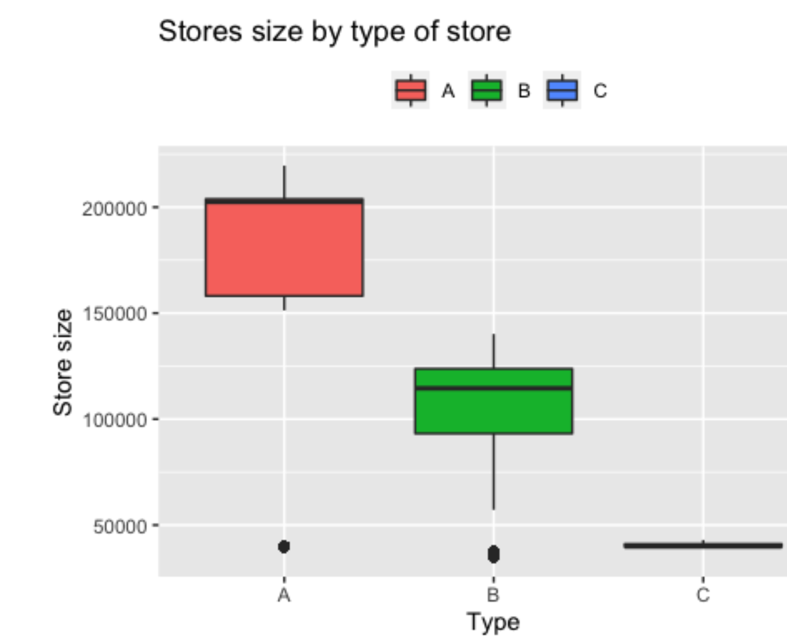
Contd...
Store type “A” has the biggest store, followed by ‘B’ and the smallest is the type “C”

Slide 10
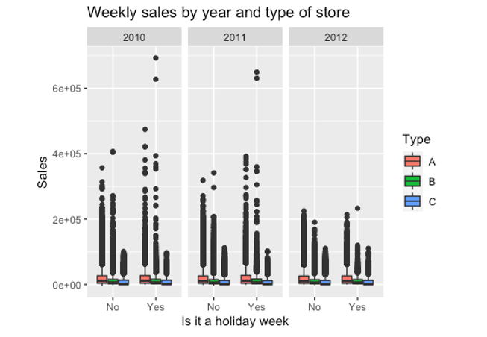
Contd...
Weekly sales are higher during holidays for year 2010 and 2011. There is exception present in 2012.

Slide 11
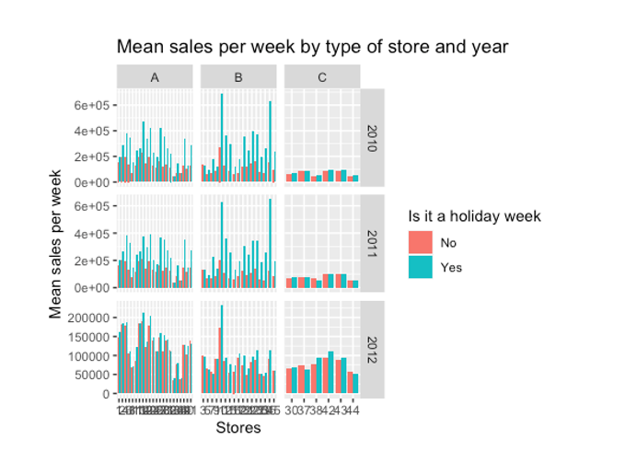
Contd...
In 2012 the data FOR the Christmas holiday is not available and the mean weekly sales are smaller.
Also, the medium stores have more weekly sales, mostly on holiday weeks in most of the cases.

Slide 12
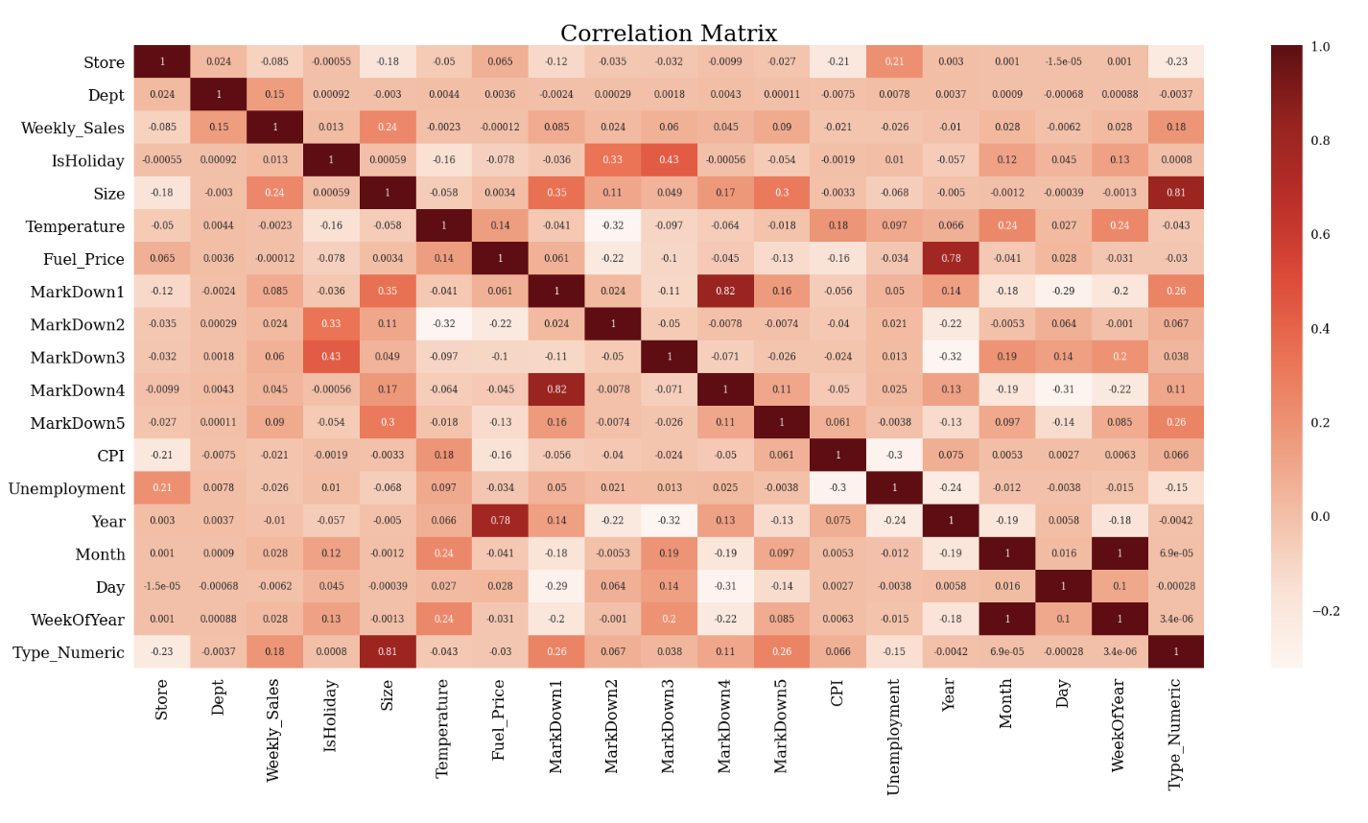
Feature Selection: Identify & Select Important Factors
Size
Dept
Week
Year
IsHoliday
Temperature. Fuel price, CPI and Unemployment are very weakly correlated with the weekly sales
Notes:
• Department, Store size and Type have moderate correlation with the weekly sales
• Markdown1-5 have very weak correlation with the weekly sales, so we will leave these columns out
• Temperature. Fuel price, CPI and Unemployment are very weakly corelated with the weekly sales,
so these columns will also be dropped out
• IsHoliday will be considered for the further analysis as the sales in the holiday weeks are higher than
in the non-holiday weeks
• We will also leave out Month and Day as this information is already contained in the Week

Slide 13
Model Building
Split dataset into training and testing based on 80/20 split
Scale training and testing datasets
Fit algorithms:
Linear Regression
Partial Least Squares
Principal Component Regression
Ridge Regression
LASSO regression
Predict on test values
Tune models
Report test MSE and RMSE for "Weekly_Sales" prediction

Slide 14
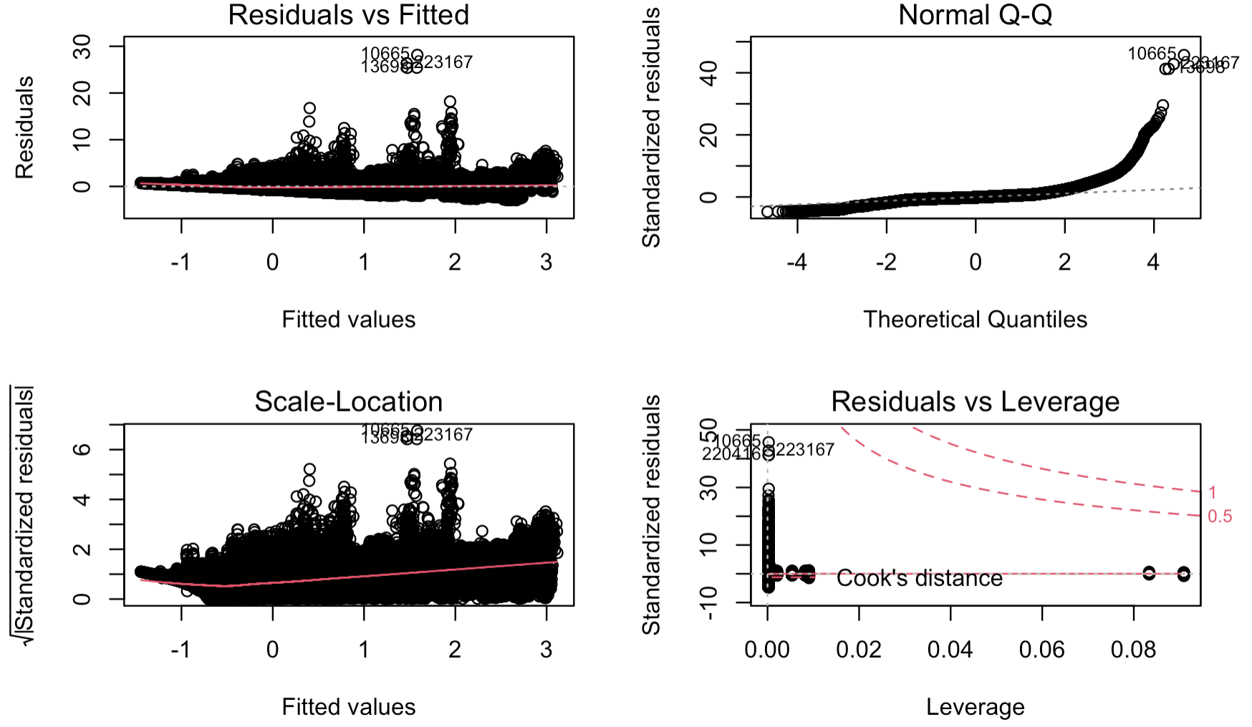
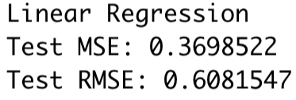
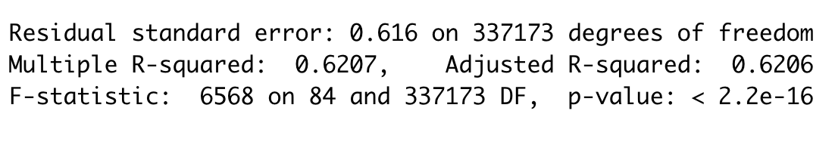
Linear Regression
All factors showed statistically significant results
"Dept92" had the largest coefficient of 2.457497
Evidence of non-linear data

Slide 15
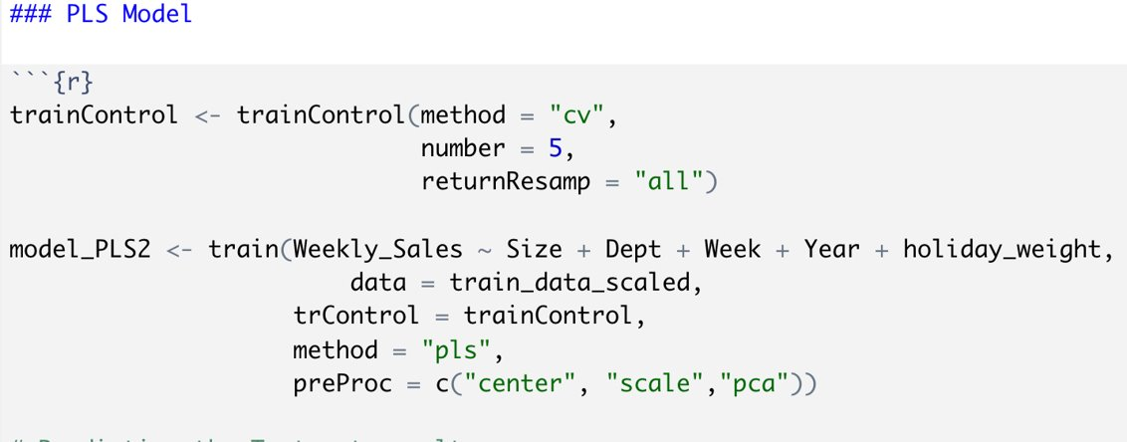
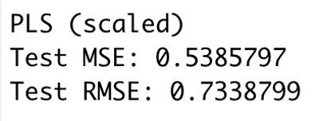
Partial Least Squares: Cross-Validation

Slide 16
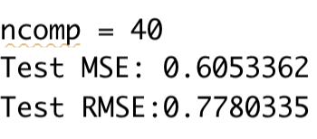
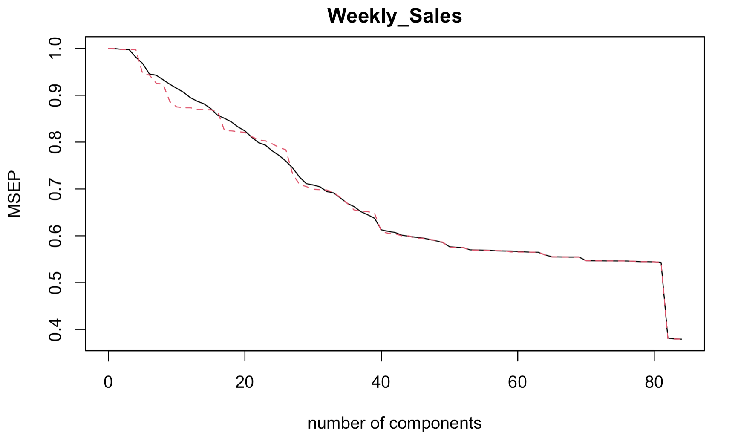
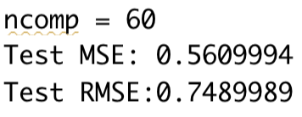
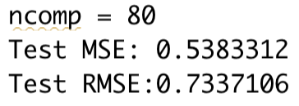
Validation Plot for PCR for optimal # of components
80 > 60 > 40

Slide 17
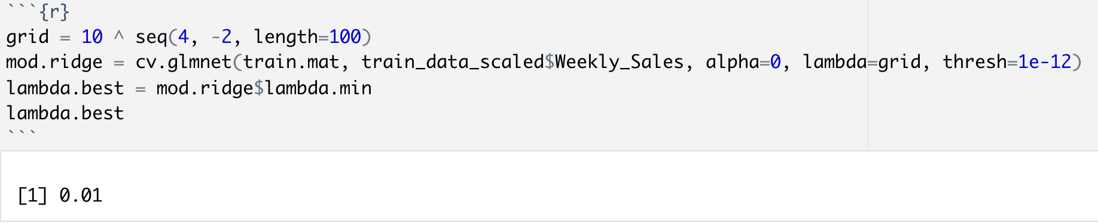
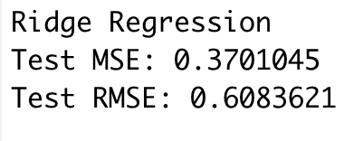
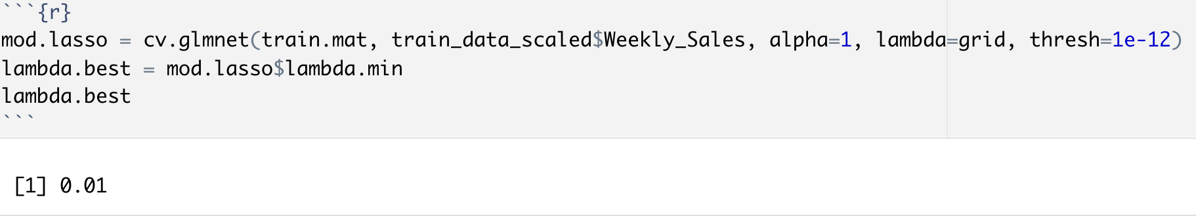
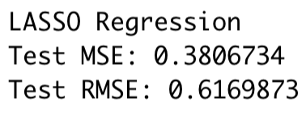
Ridge & LASSO Model Tuning: Best lambda value
Pick the lambda value using train data and report error on test data

Slide 18
Regression Model Performance
Models​ | TEST RMSE​ | TEST MSE​
(#1) Multiple Linear​ | 0.6081547​ ​ | 0.3698522​ ​
(#2)Ridge​ | 0.6083621​ ​ | 0.3701045​
(#3) Lasso​ | 0.6169873​ | 0.3806734​ ​
(#5)PCR​ | 0.7489989​ ​ | 0.5609994​ ​
(#4)PLS​ | 0.7338799​ ​ | 0.5385797​ ​

Slide 19
Regression Model Performance (not scaled)
Models​ | TEST RMSE​ | TEST MSE​
(#2) Multiple Linear​ | 13655.18​ ​ | 186464028​ ​
(#1)Ridge​ | 13655.17​ ​ | 186463787​
(#3) Lasso​ | 13655.18​ | 186464036​ ​
(#4)PCR​ | 16475.14​ ​ | 282872712​ ​
(#5)PLS​ | 16478.9​ ​ | 271554049​ ​

Slide 20
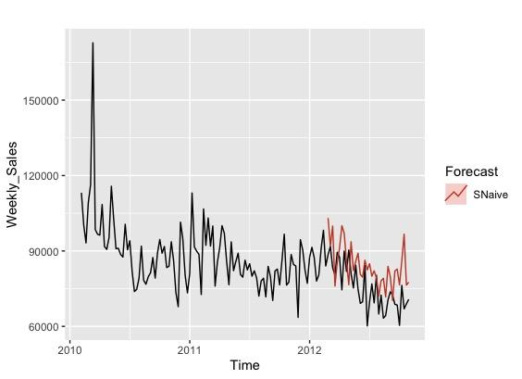
Time Series Models
Ability to capture seasonality patterns.
Observations from year before considered as forecast values
WMAE: 1688

Slide 21
Conclusion
Model Interpretability and performance: Linear models are highly interpretable but fail to capture the non - linear relationships between events like promotions and holiday seasons.
Ridge regression was another high performing model to predict "Weekly_Sales"
Ridge regression works with the advantage of not requiring unbiased estimators – rather, it adds bias to estimators to reduce the standard error. It adds bias enough to make the estimates a reliable representation of the population of data.

Slide 22
Recommendations Research Answers
Apart from Labour day, rest of the holiday seasons boost sales so promotions should be focused then.
Size, Dept, and IsHoliday are significant in increasing sales
Temperature, Fuel Price, CPI do not impact sales
Holiday sales are highest in the medium sized stores.

Slide 23
Future Work
Use historical sales as a factor to predict future sales.
Apply gradient boosting regression models and compare with existing models.
Add trend and seasonal dummies or fourier terms to linear model due to seasonality patterns in the data
Use time series models with automatic algorithms to select model parameters like ets and auto.arima
Adjust the data using time series decompositions like STL over dynamic harmonic regression

Slide 24
THANK YOU !

Slide 25
QUESTIONS?

